Slide 1
NLM Medical Subject Headings (MeSH) Entry Terms
PEARL Meeting 4/21/16
Anna Ripple (CgSB/LHNCBC/NLM/NIH)

Slide 2
What are ‘Entry Terms’
Synonyms, alternative forms for Preferred Terms
In Controlled Vocabularies provide linkages from usage terms or variants to controlled (Preferred) terms
Can be thought of as ‘access points’ to Preferred Terms
Conceptually similar to Lower Level Terms (LLTs) in MedDRA to Preferred Terms (PTs)

Slide 3
MeSH Entry Term File
Separate from MEDLINE 2016 data refresh files; value-added file for PEARL prototype
Extracted by NLM from 2016 MeSH vocabulary
Tconnex to implement an index file based on MeSH entry terms to faciliate PEARL Drug search first; Adverse Event terms later

Slide 4
Why a MeSH entry term Index for PEARL?
Currently, PEARL drug search is limited to only MeSH preferred terms for drugs
Adding entry terms will allow additional access points, so that users can enter the drug name by which they know it without having to know the MeSH preferred terms

Slide 5
MeSH Entry Term Example
Dapagliflozin is an entry term for the MeSH drug 2-(3-(4-ethoxybenzyl)-4-chlorophenyl)-6-hydroxymethyltetrahydro-2H-pyran-3,4,5-triol (MeSH_drug code C529054)

Slide 6
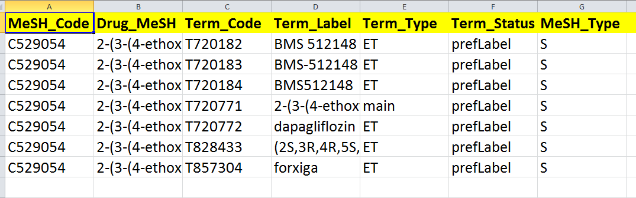
Dapagliflozin example
Preferred Term for MeSH Code C529054 equal to string found in Drug_MeSH) (Preferred Term coding ‘main’ for |Term_Type| and ‘prefLabel’ for Term_Status|)

Slide 7
Dapagliflozin example
Entry Terms
Entry Terms
Most Entry Terms have coding ‘ET’ for |Term_Type| and ‘prefLabel’ for |Term_Status|.

Slide 8
Recipe for using MeSH Entry Term
Download zipped Excel file (65 megs) from NLM (Anna will email)
Data will have following Headers
Export NLM file into your computing environment
PEARL Drug Entry Term index only needs include MeSH codes found in data.

Slide 9
MeSH Entry Term File Notes
MeSH_Codes are 7 or 10 alphanumeric starting with the letter D or C.
Term_Codes are 7 or 10 alphanumeric starting with the letter T.
(Most codes are 7 characters—the 10 characters started in May, 2014)
There can be many Term_Codes to each MeSH_Code (many to one relationship)
Term_Label is the Term_Code as Drug_MeSH is to MeSH_Code

Slide 10
MeSH Entry Term File Notes (cont)
Term_Type can have values of 'main', ‘ET'.
Term_Status can have values of ‘prefLabel', ‘altLabel‘
Terms that are coded with 'main' and 'prefLabel' are the PTs for the MeSH_Code/Drug_MeSH.
Terms that are coded with ‘ET’ for |Term_Type| and ‘prefLabel’ for |Term_Status| are Entry Terms; sometimes Entry Terms will have ‘altLabel’ for |Term Status|
MeSH_Type can have one of three values: D, S, Q and refers to ‘Descriptor’, ‘Supplementary Concept’ , ‘Qualifier’. This is data that was part of the extraction process for tracking purposes.

Slide 11
How will Entry Terms be presented? Dapaglifozin Example
How to present to PEARL user that the Entry term mapped to MeSH preferred term
Cannot substitute Entry Terms for MeSH preferred terms contained in ADE Data
PubMed solves this problem with a ‘Search Details’ box where the MeSH preferred mapping is displayed (‘Search Details’ similar to PEARL ‘Audit Trail’ functionality)

Slide 12
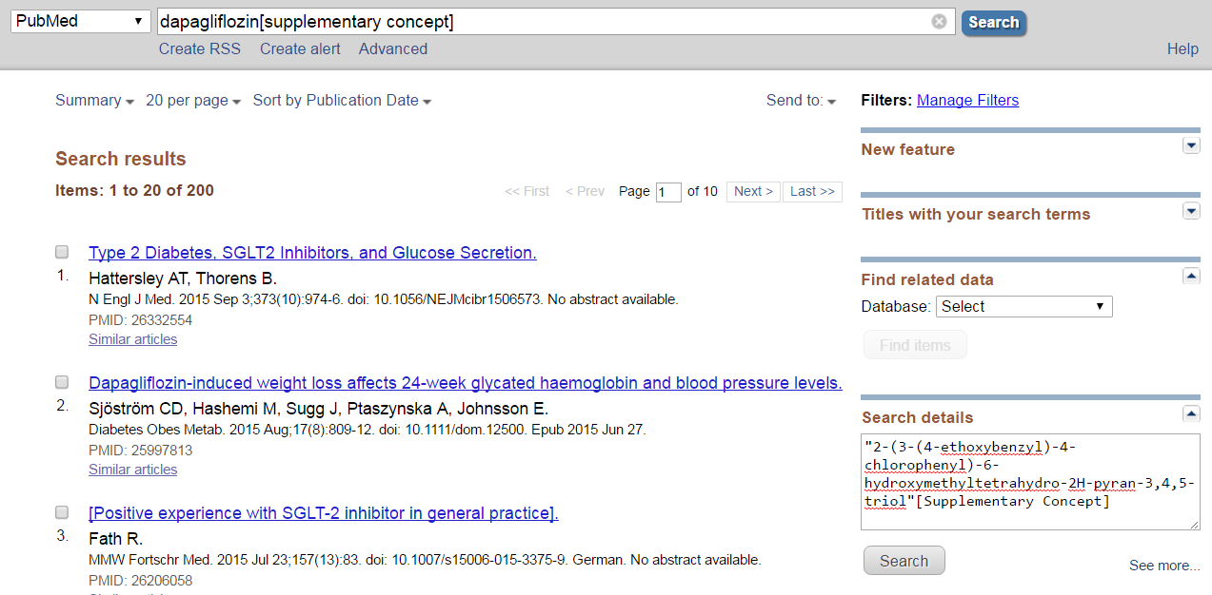

Slide 13
Discussion
Live PubMed demo for Dapagliflozin example
Questions

